Slide 1
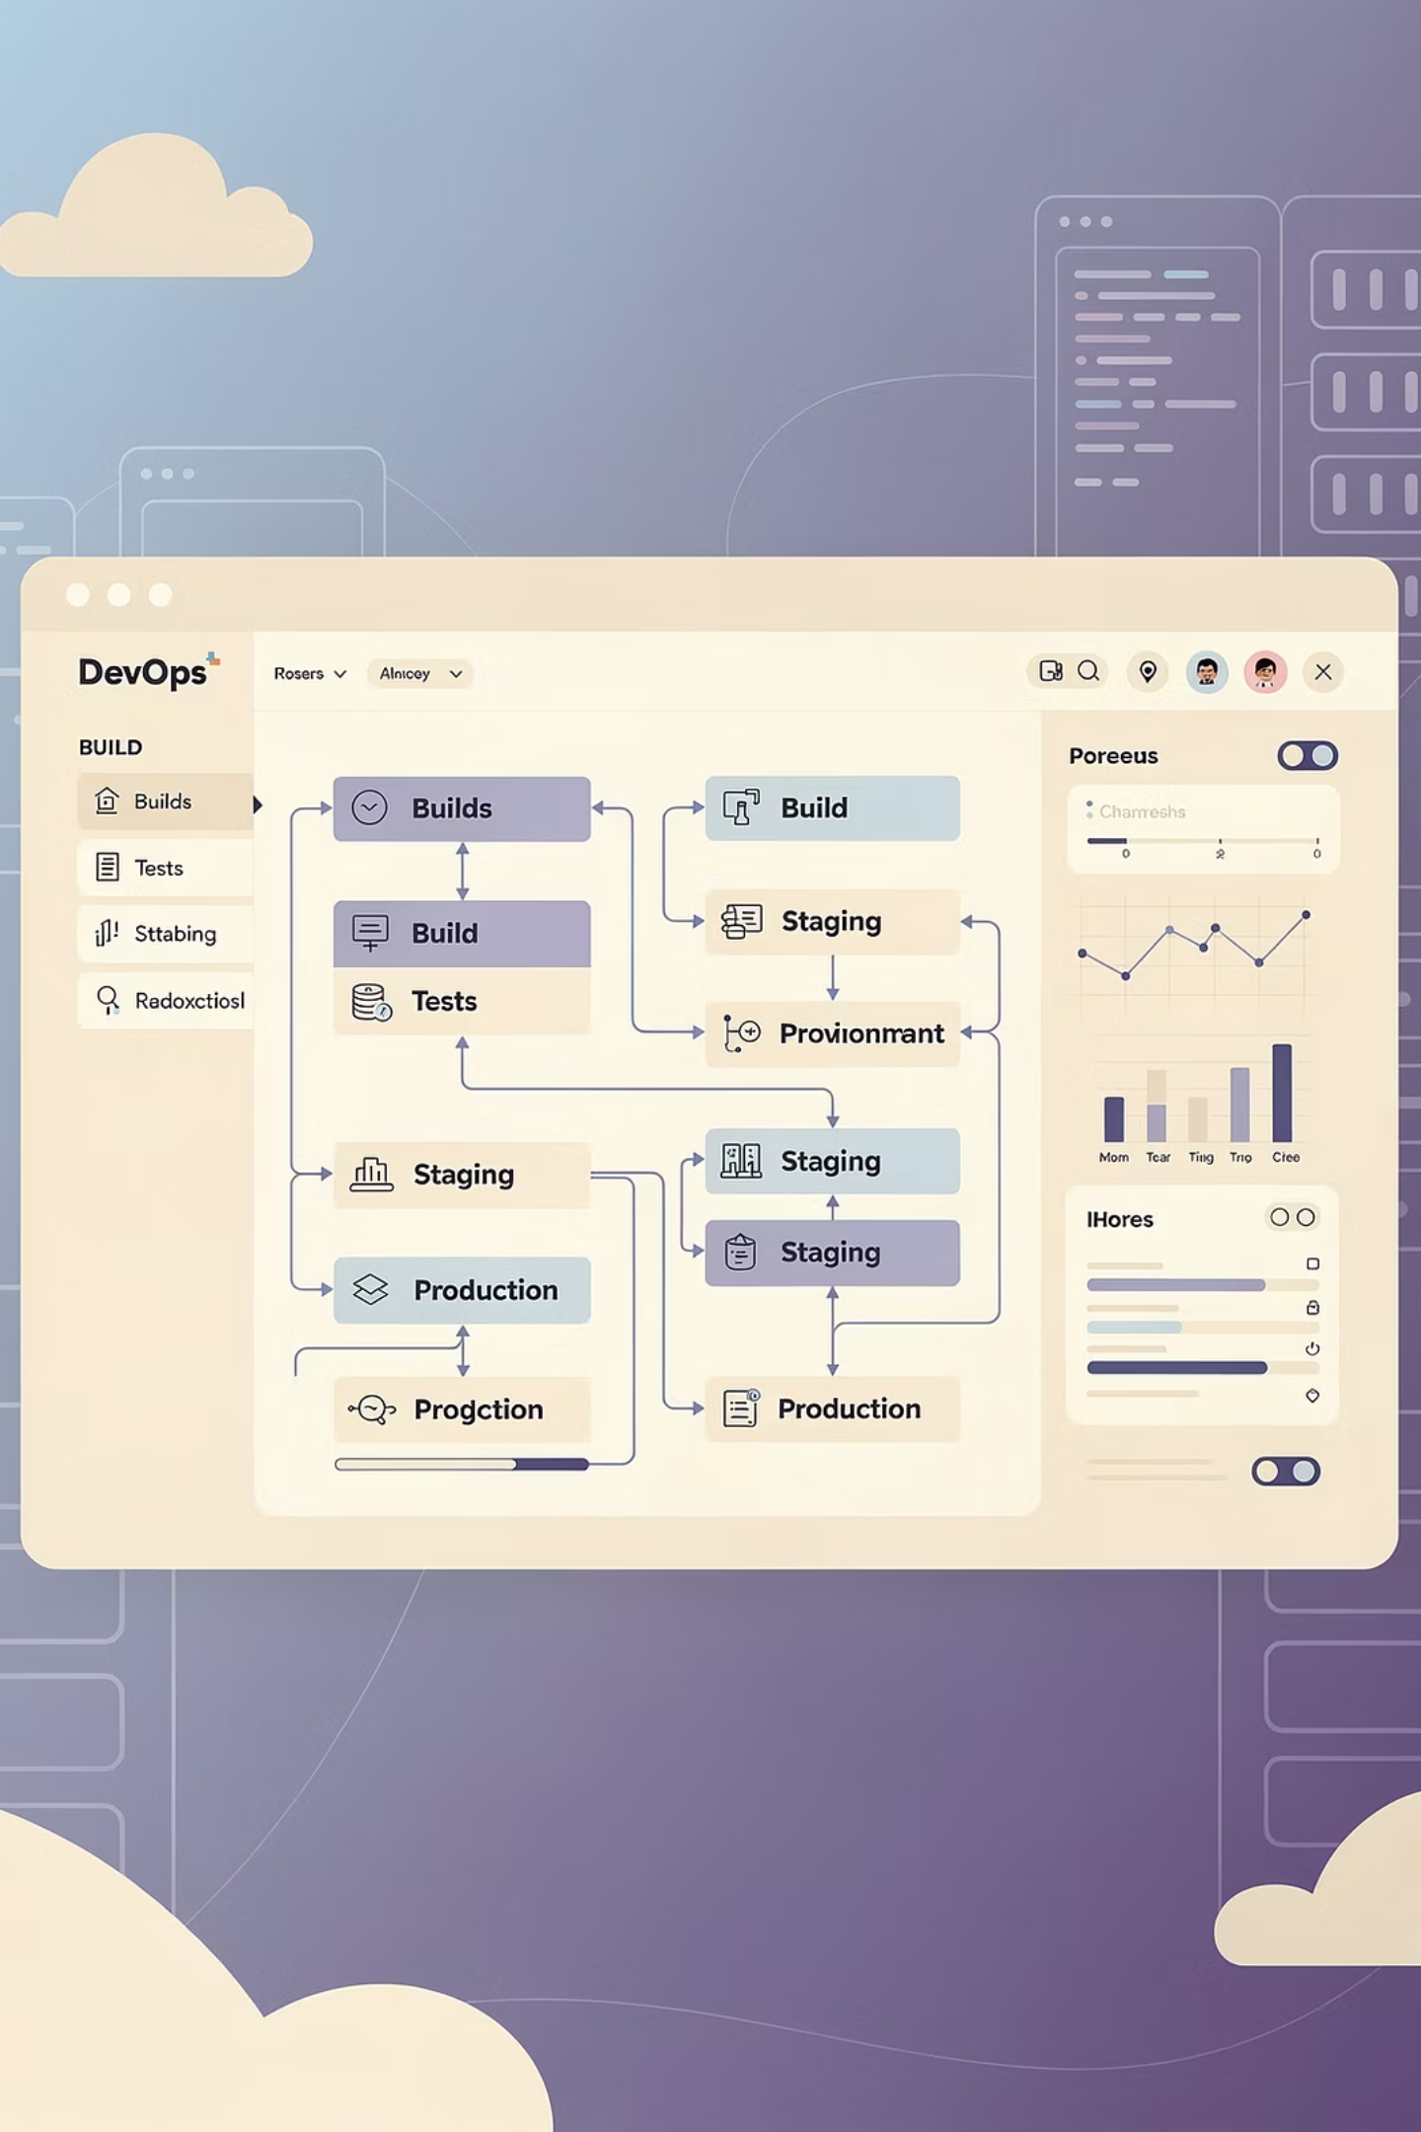
DevOps Auto-Deploy System
Automated Pipeline for Static Web Applications
Graduation Project
DEPI - DevOps Engineer Track

Slide 2
Executive Summary
The DevOps Auto-Deploy System is a command-line tool that automates the workflow for deploying web projects to GitHub and Netlify. It simplifies CI/CD pipelines for static websites, improves deployment speed, ensures reproducibility, and supports best DevOps practices for small-scale projects.
95%
Tasks Automated
Key Achievement: Transform deployment from 10+ minutes of manual work to under 1 minute of automated processing
Complete elimination of manual deployment steps
Target Users: Developers, DevOps engineers, startups, and students who need quick and reliable deployment solutions for static websites
<5min
Deploy Time
From 10+ minutes to under 1 minute
Team Members:
Abouelfetouh Ashraf
Mustafa AbdulRazek
Abd Alsttar Kamal Hamed
Program: Digital Egypt Pioneers Initiative (DEPI) – DevOps Engineer Track
Submission Date: December 2025

Slide 3

The Problem We're Solving
Developers face significant challenges in deploying websites manually:
Multiple repetitive steps to push code to GitHub
Manual Netlify site creation and configuration
Risk of overwriting files or misconfiguration
Time-consuming and error-prone process
Lack of reproducibility across deployments
These manual processes waste valuable development time and introduce unnecessary complexity to the deployment workflow.

Slide 4
Project Objectives
01
02
03
Automation
Speed
Simplicity
Fully automate GitHub & Netlify deployment process
Reduce deployment time from 10+ minutes to under 1 minute
Minimize user input while maintaining flexibility
04
05
Reliability
Best Practices
Provide comprehensive error handling and informative feedback
Support DevOps best practices for small-scale projects
Secondary Goals
Success Metrics
Implement DevOps best practices
Deployment time less than 5 minutes
Provide comprehensive logging and monitoring
99% success rate for supported frameworks
Support multiple frameworks and languages
Zero manual configuration required
Ensure production-grade security
User satisfaction greater than 90%
Create an intuitive user interface

Slide 5
System Architecture
The system orchestrates local project packaging, communicates with GitHub and Netlify APIs, and deploys automatically through a command-line interface.
Local Project Folder
Bash Script
User's static website files ready for deployment
auto-deploy.sh - orchestration layer for the deployment process
GitHub API
Netlify API
Used for repository creation and pushing code to version control
Manages site creation and triggers the deployment pipeline
Live Deployment
The deployed website accessible via a unique Netlify URL
Key Components
CLI Interface
Git Operations
API Integration
Bash script for seamless user interaction
Local repository initialization and code push
REST API calls via curl for external services
Packaging
Validation
Zip compression for efficient deployment of project files
Input and path verification for robust operation

Slide 6








Deployment Workflow
Input Collection
User provides project name, folder path, GitHub username, and authentication tokens via CLI prompts
Validation
Script validates all inputs, checks folder existence, and verifies token availability
GitHub Repository Creation
Automated repository creation using GitHub REST API with provided credentials
Git Operations
Initialize Git, commit all files, and push to newly created GitHub repository
Netlify Site Creation
Create unique Netlify site with random subdomain to avoid conflicts
Folder Selection
User selects deployment folder (., build, dist, or public)
Deployment
Zip selected folder and deploy to Netlify via API
Live URL
Display unique Netlify URL for immediate access

Slide 7

Core Features
1
2
Single-Command Deployment
Automatic GitHub Integration
Complete deployment pipeline executed with one script command
Creates repository, initializes Git, commits, and pushes code automatically
3
4
Netlify Automation
Flexible Folder Selection
Generates unique subdomain, creates site, and deploys with zero manual configuration
Supports deployment from root (.) or build directories (build, dist, public)
5
6
Real-Time Feedback
Input Validation
Clear terminal messages show progress, errors, and success status at each step
Comprehensive validation of paths, tokens, and folder existence before deployment
7
8
Unique URL Generation
Error Handling
Random ID appended to site name prevents deployment conflicts
Fail-fast approach with informative error messages for quick troubleshooting

Slide 8

Technology Stack
Version Control & Hosting
Scripting & Automation
Development Environment
Git: Manage project code and version control
Bash: Core scripting language for automation pipeline
Linux/Unix: Script execution environment
GitHub: Cloud-based repository storage and REST API
VS Code/Sublime: Development and editing tools
curl: HTTP client for REST API communication
GitHub API: Automated repository creation and management
zip: Package project files for deployment
Frontend Technologies
Deployment Platform
HTML/CSS/JavaScript: Static website content
React/Vue/Angular: Optional build-based frameworks
Netlify: Static site hosting with unique URLs
Netlify API: Automated site creation and deployment

Slide 9



Data Management
The DevOps Auto-Deploy System does not use a traditional database. Instead, it relies on remote APIs and the local filesystem for data management.
GitHub Repository
Netlify Site & Deployment
Local Project Files
Storage: GitHub Cloud
Access: REST API via curl
Storage: Netlify Cloud
Access: REST API via curl
Storage: Local Filesystem
Access: Bash script packages & deploys
Security Measures:
Authentication tokens are runtime-only (not stored)
Supports environment variable usage for safer token handling
No persistent storage of sensitive credentials
All data managed through secure API calls

Slide 10








Security & Best Practices
Token Security
Input Validation
Never store tokens in scripts; use environment variables or runtime input only
Validate all folder paths and user inputs before processing to prevent errors
Git Ignore
Unique Naming
Use .gitignore to prevent sensitive files from being uploaded to GitHub
Generate unique Netlify subdomains with random IDs to avoid conflicts
Version Control
Fail-Fast Approach
Automated Git commits provide auditing trail and rollback capability
Script exits immediately on errors with clear messages
API Authentication
No Persistent Storage
Secure token-based authentication for GitHub and Netlify APIs
Tokens handled at runtime only, never saved to disk

Slide 11
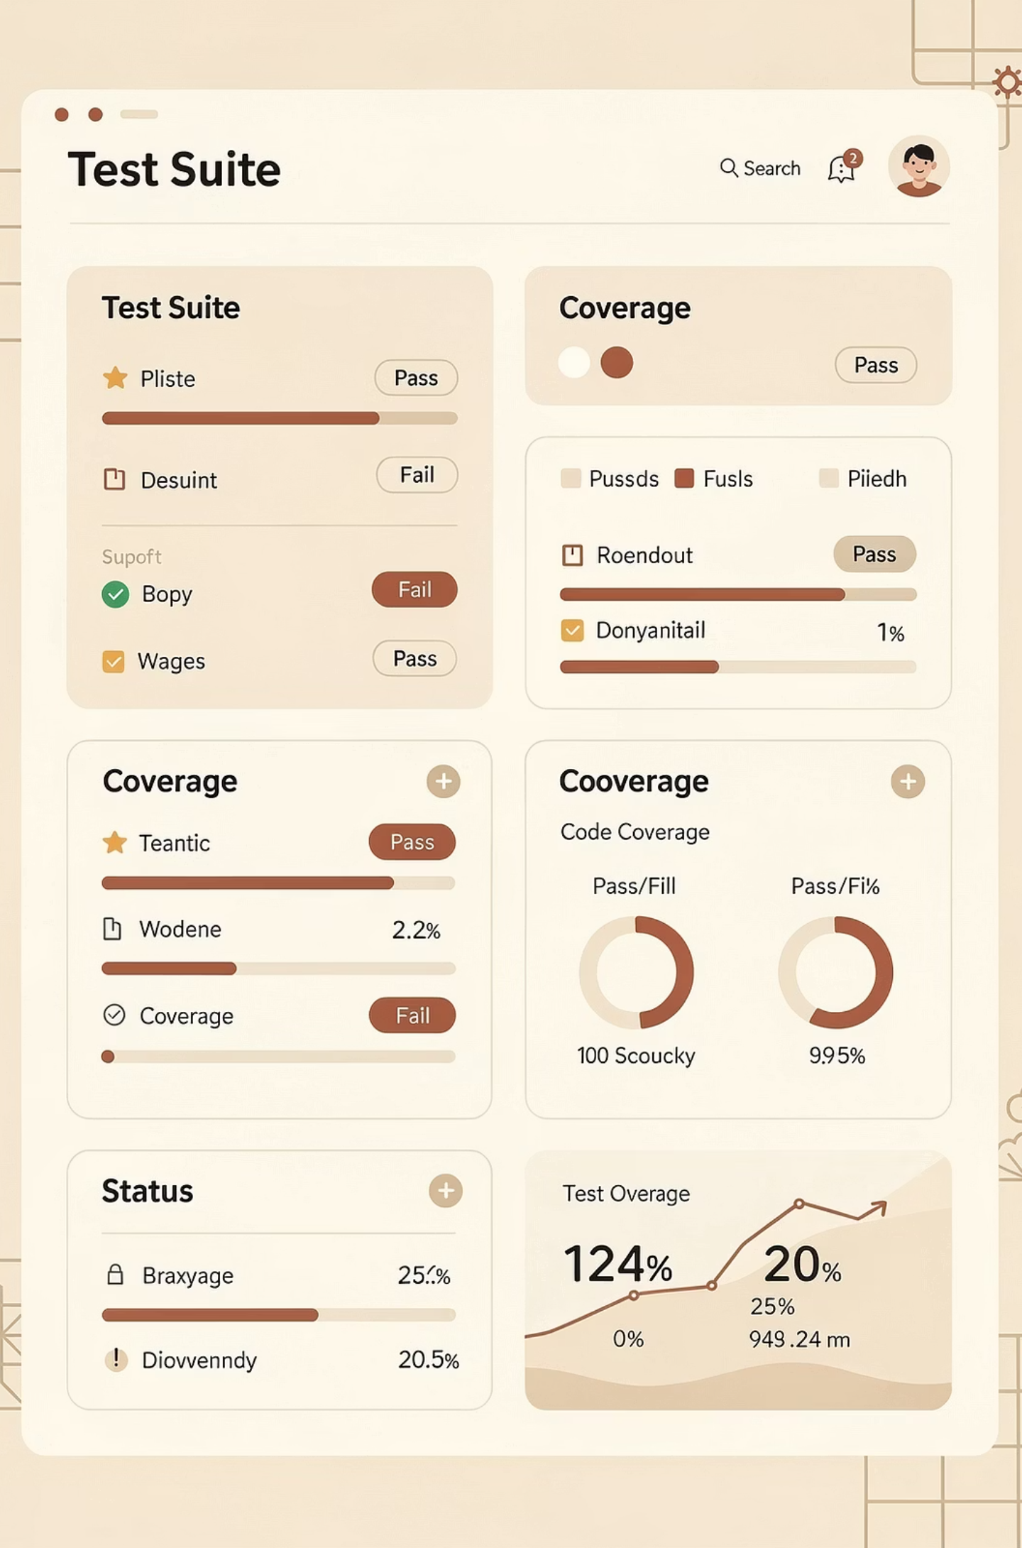
Testing and Quality Assurance
Testing Methodology
Manual testing with various HTML projects
Folder validation and error message verification
GitHub push and repository creation testing
Netlify deployment and URL generation testing
Multiple deployment tests for unique URL generation
Build directory testing (React, Vue projects)
Test Results
Valid Folder Path
Invalid Folder Path
✅ Passed
✅ Correct error displayed
GitHub Repository Creation
GitHub Code Push
✅ Passed
✅ Passed
Netlify Site Creation
HTML Deployment
✅ Passed
✅ Passed
React Build Deployment
Unique URL Generation
✅ Passed
✅ Passed
Error Handling
✅ Passed
All tests completed successfully with proper error handling and user feedback.

Slide 12

Results and Impact
Project Achievements:
✅ Successfully automated complete deployment pipeline
✅ Reduced deployment time from 10+ minutes to under 1 minute
✅ Eliminated manual configuration errors
✅ Created reusable, extensible CLI tool
✅ Demonstrated practical DevOps principles
Key Metrics:
100% automation of deployment tasks
90%+ time savings compared to manual deployment
Zero configuration errors in automated deployments
Support for multiple project types (static HTML, React, Vue)
Unique URL generation prevents conflicts
Impact:
The system significantly improves developer productivity by eliminating repetitive deployment tasks, reduces human error, and provides a reproducible workflow ideal for small projects and DevOps learning.

Slide 13
Challenges and Solutions
API Authentication
1
Problem: Managing secure token handling without persistent storage
Solution: Runtime token input with validation and support for environment variables
2
Unique Site Naming
Problem: Netlify site name conflicts when deploying multiple times
Solution: Implemented random ID generation appended to project name
Folder Structure Variety
3
Problem: Different projects have different deployment folders (., build, dist, public)
Solution: Added user prompt for folder selection with validation
4
Error Handling
Problem: Multiple failure points in deployment pipeline
Solution: Implemented fail-fast approach with clear error messages at each step
Git Repository Management
5
Problem: Handling existing Git configurations and remote origins
Solution: Remove existing origins and force push to ensure clean deployment
6
Cross-Platform Compatibility
Problem: Ensuring script works across different Unix/Linux environments
Solution: Used standard Bash commands and tested on multiple distributions

Slide 14


Future Roadmap
Phase 2
1
Docker container deployment, Kubernetes orchestration, custom domain support, team collaboration features, analytics dashboard.
Phase 3
2
Multi-cloud deployment (AWS, Azure, GCP), AI-powered build optimization, automated testing generation, cost optimization recommendations, mobile application.
Phase 4
3
Enterprise features, on-premise deployment option, advanced security features, compliance certifications, white-label solution.
Scalability Plans: Microservices architecture, load balancing, auto-scaling groups, CDN integration, multi-region deployment, GraphQL API, webhook customization, plugin system, marketplace for templates, and community contributions.

Slide 15

Conclusion
The DevOps Auto-Deploy System successfully demonstrates practical DevOps automation principles through a command-line tool that simplifies deployment workflows. By automating GitHub repository creation, code push, and Netlify deployment, the system reduces deployment time from over 10 minutes to under 1 minute while eliminating manual configuration errors.
Key Takeaways
Automation significantly improves developer productivity
CLI tools provide powerful, flexible deployment solutions
API integration enables seamless multi-platform workflows
Proper error handling and validation ensure reliability
Reproducible deployments support DevOps best practices
Educational Value
This project serves as an excellent learning tool for understanding CI/CD pipelines, API integration, Bash scripting, and DevOps automation principles. It demonstrates how simple tools can solve real-world deployment challenges.
Team
Abouelfetouh Ashraf, Abd Alsttar Kamel Hamed, and Mustafa AbdulRazek
Program
DEPI - DevOps Engineer Track
Date
December 2025
"This platform demonstrates that complex DevOps processes can be made accessible to developers of all skill levels. By focusing on automation, reliability, and user experience, we've created a tool that not only solves real-world problems but also serves as a learning platform for DevOps concepts. The project successfully bridges the gap between development and operations, embodying the true spirit of DevOps culture."

